Slide 1
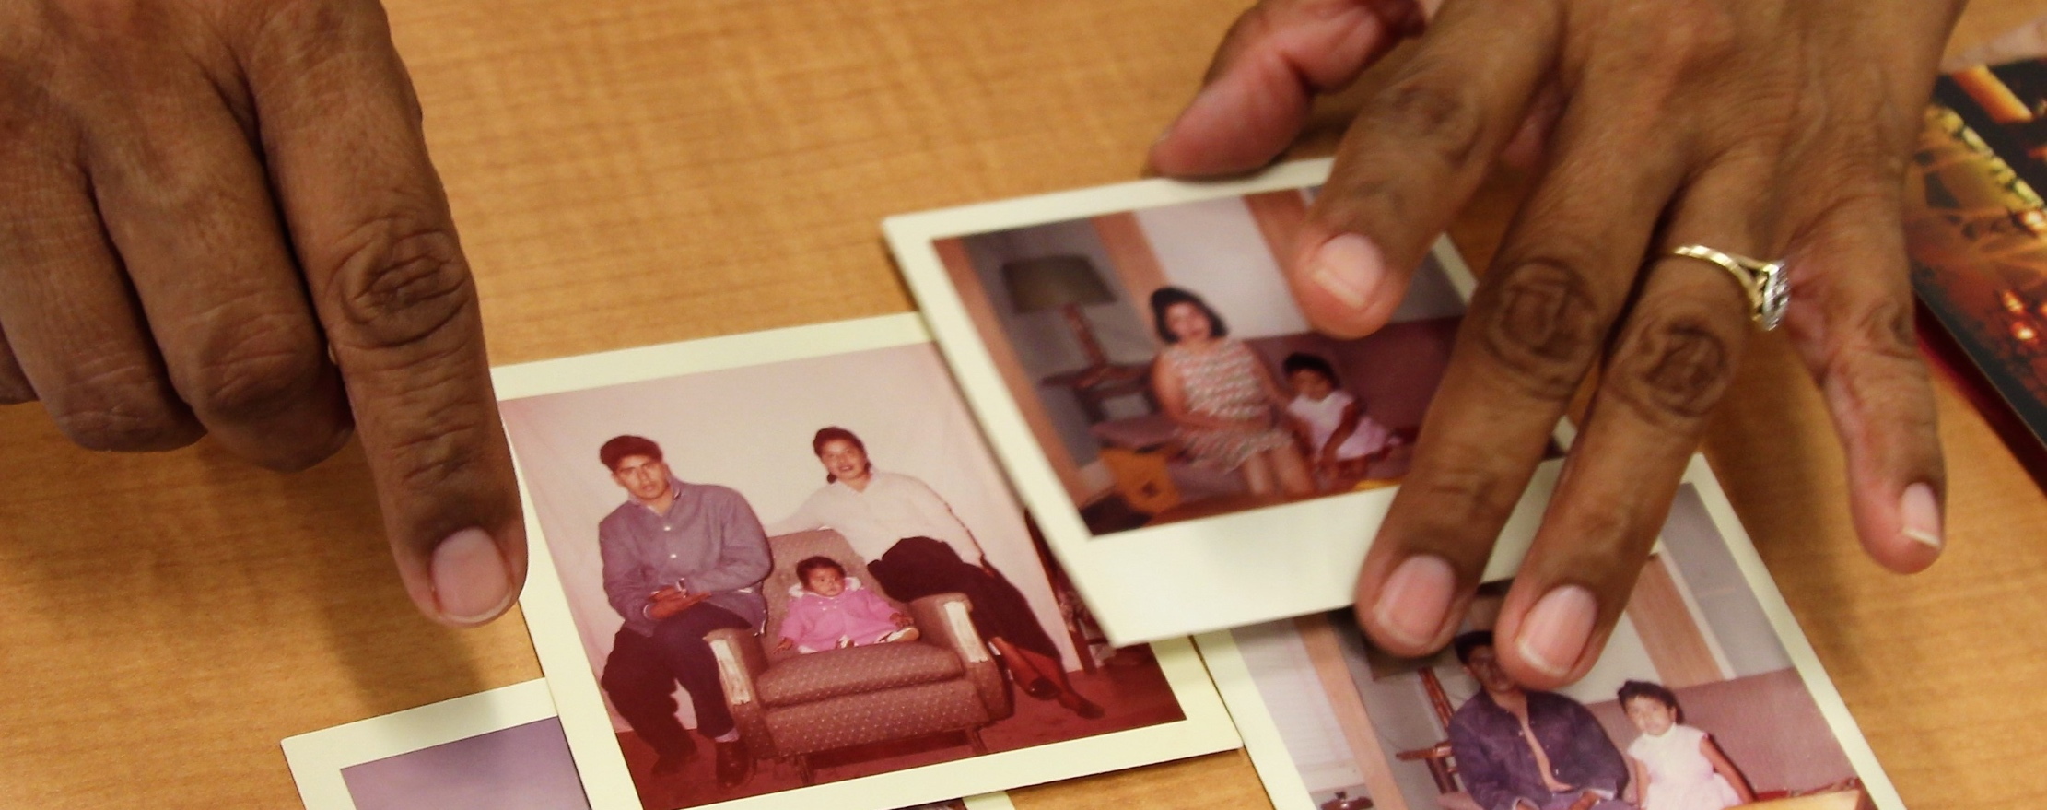
Storytelling 101
Oral History Interviews

Slide 2
Indigenous Land Acknowledgement
The ASU Library acknowledges the twenty-two Native Nations that have inhabited this land for centuries. Arizona State University's four campuses are located in the Salt River Valley on ancestral territories of Indigenous peoples, including the Akimel O’odham (Pima) and Pee Posh (Maricopa) Indian Communities, whose care and keeping of these lands allows us to be here today. ASU Library acknowledges the sovereignty of these nations and seeks to foster an environment of success and possibility for Native American students and patrons. We are advocates for the incorporation of Indigenous knowledge systems and research methodologies within contemporary library practice. ASU Library welcomes members of the Akimel O’odham and Pee Posh, and all Native nations to the Library.

Slide 3
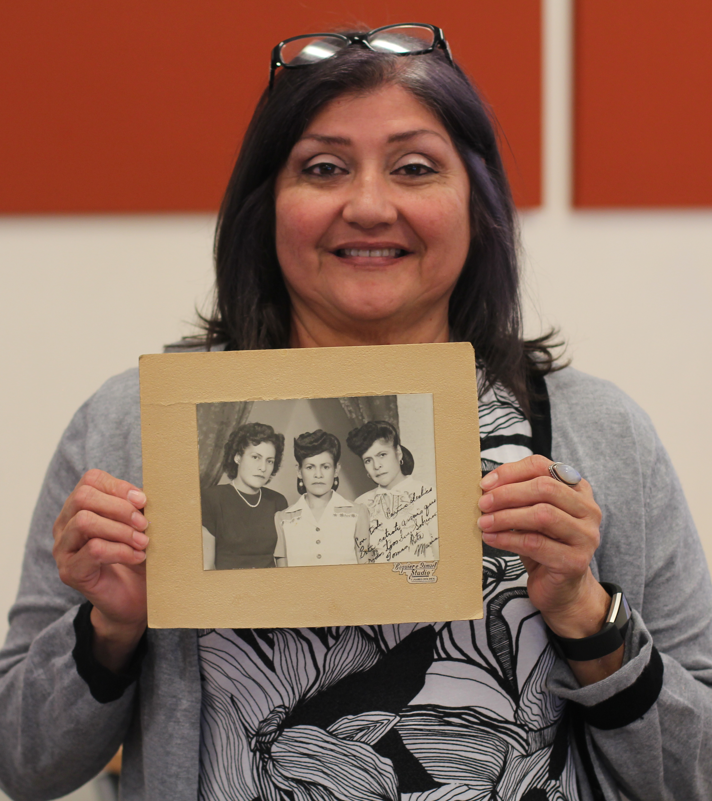
Community-Driven Archives (CDA) Initiative
Established in 2017 with the support of
Andrew W. Mellon Foundation,
CDA seeks to:
Work with Arizona’s Latino, Black,
Asian & Pacific Islander, Indigenous, and
LGBTQ communities to preserve history.
Create intergenerational and intersectional safe spaces that reimagine archives and support lifelong learning.
Acknowledge historical trauma by supporting community led healing
projects that break cycles of erasure.
Provide access to archival collections
and free library resources.

Slide 4
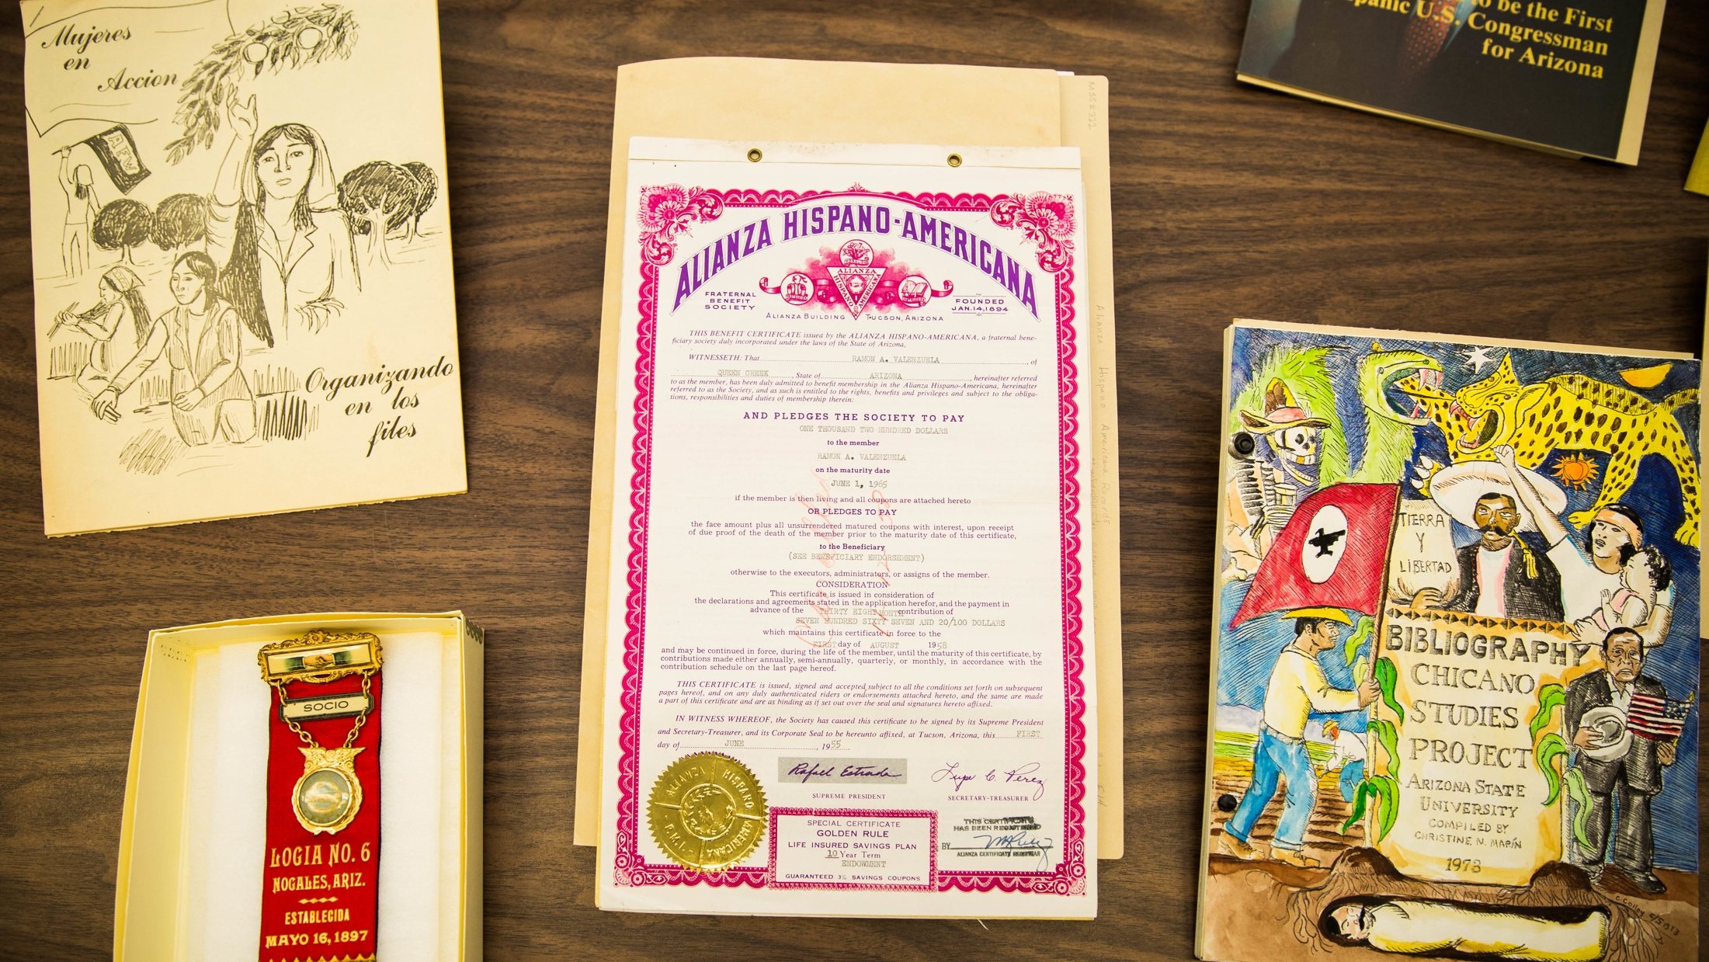
What’s an Archive and Archivist?
Archive: time capsule and active space where past and present merge. Contains primary resources that preserve the history of several generations.
Archivist: appraises, arranges, describes, and preserves archives.

Slide 5
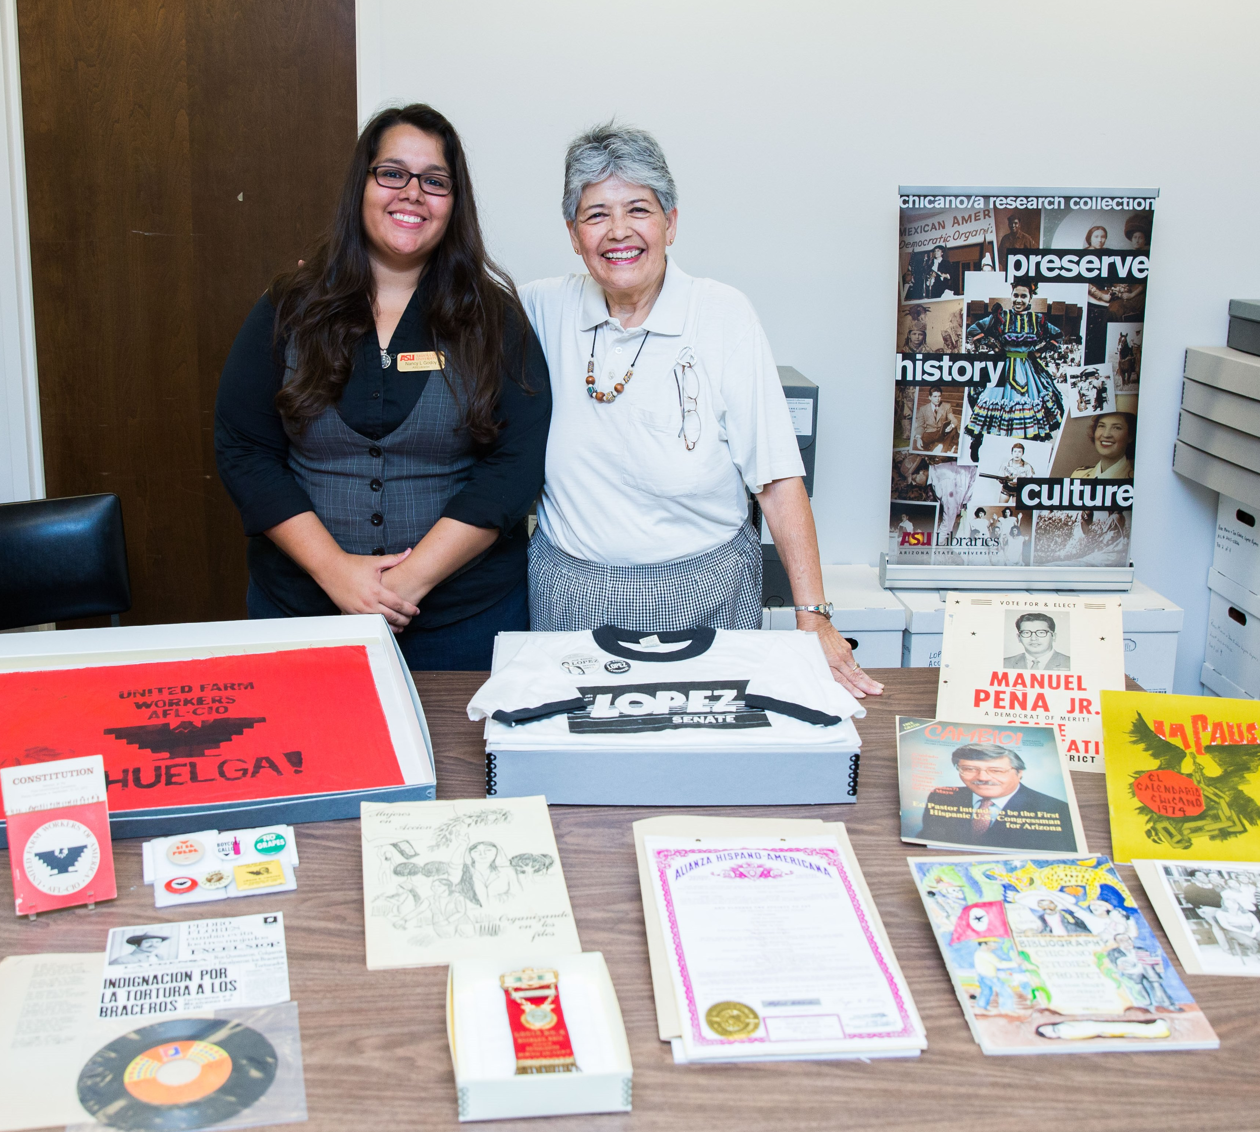
Chicano/a Research Collection
Established in 1970 by
Dr. Christine Marin when
she was a student during the Chicano – Civil Rights Movement.
Largest archive in the state that focuses on Latino history. We have collections on mining history, farm workers, activism, politics, culture,
and family history.

Slide 6
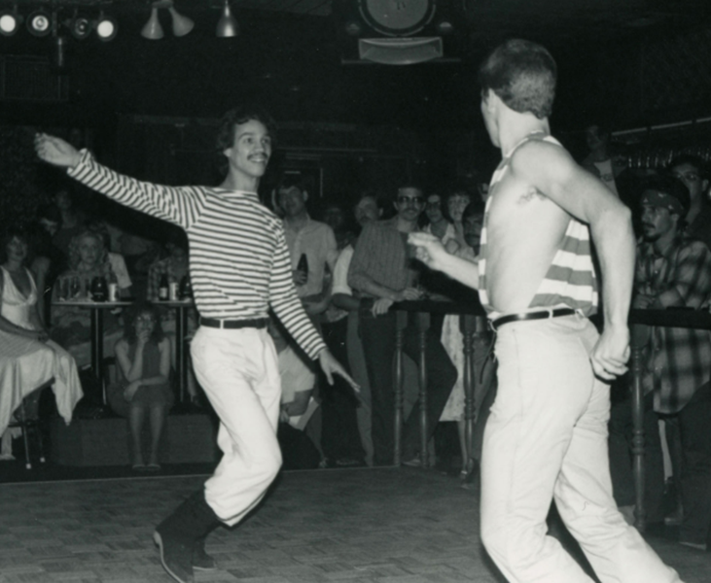
Bj Bud Memorial
Archives
Documents LGBTQ history from the late 1970’s to early 2000’s.
The collection was named after a local lesbian activist named Harlene "Bj" Bud.

Slide 7
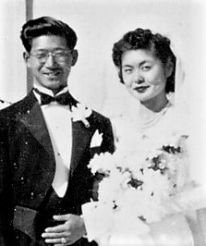
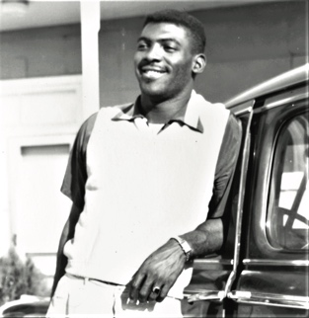
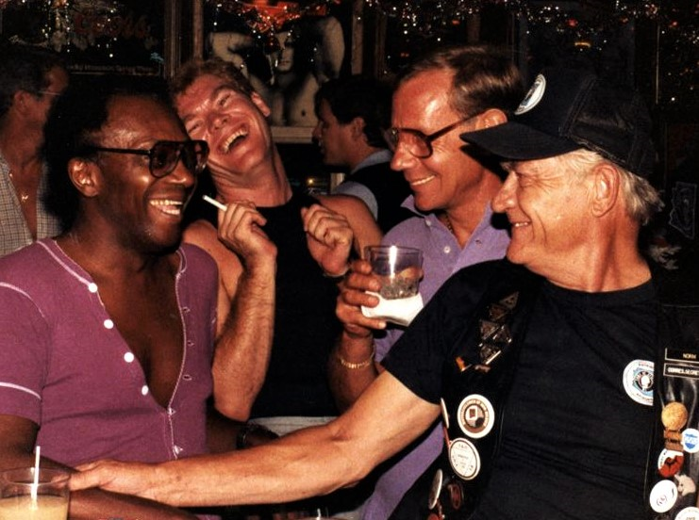
Why do we need to preserve?
Arizona Archives Matrix Project (2012)
Latinx, Black, Asian and Pacific Islander, and LGBTQ community make
up over 42% of Arizona’s population but are only represented in 0 to 2%
of known archival collections.

Slide 8
Ready to be a Community Archivist!
What’s an oral history interview?
The verbal preservation
of history and memory.
This method allows individuals to create and control their own narratives!

Slide 9
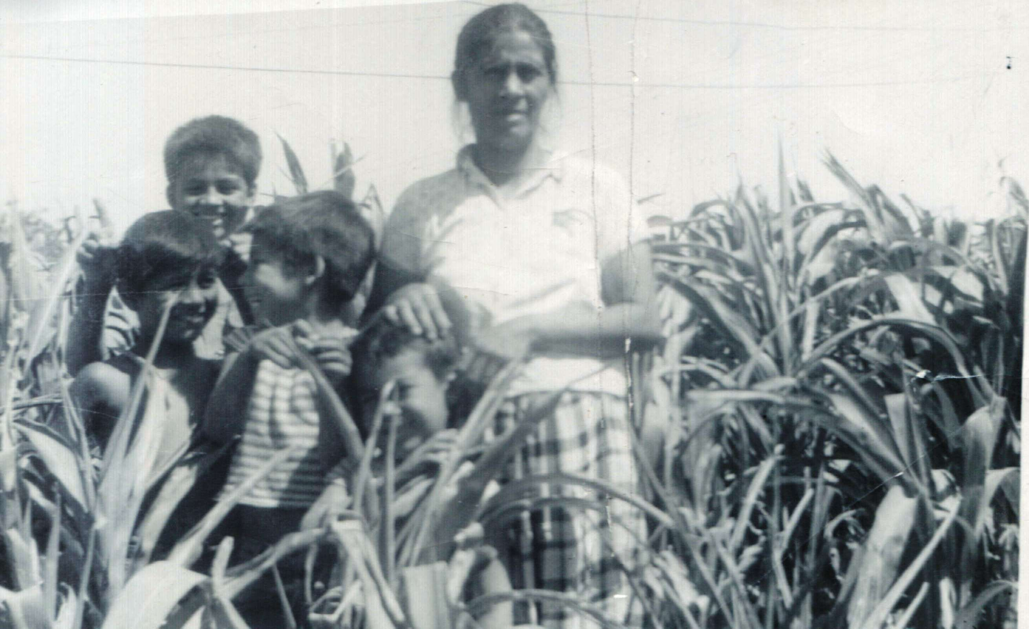
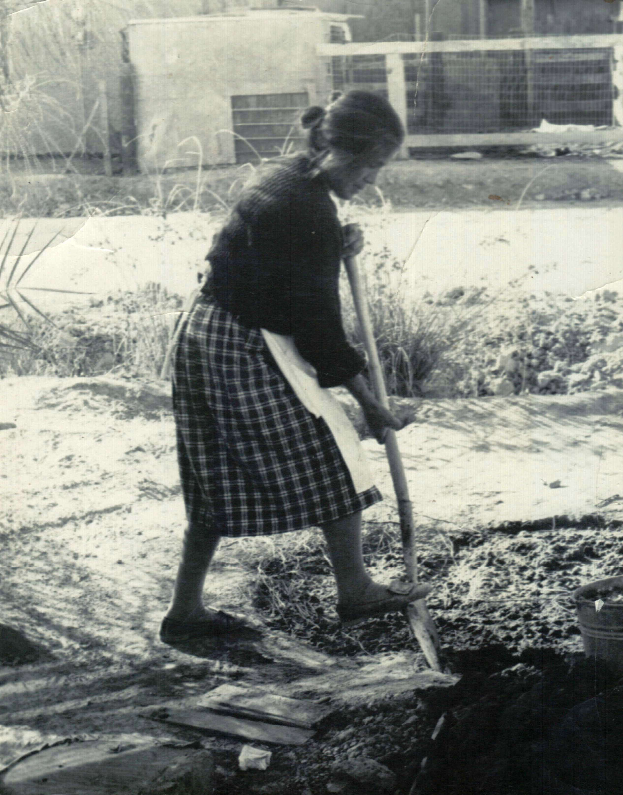
Show and Share Activity: Who would you interview? Why?

Slide 10
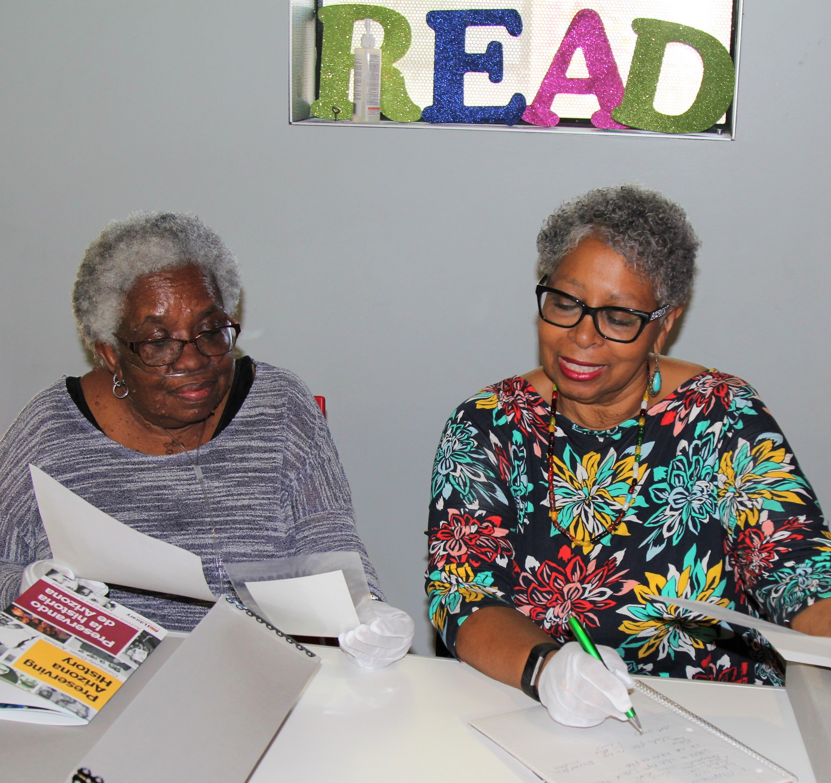
1. Select person to interview
Choose the oldest family or community member. Ask the person if they want to record the interview in English, Spanish, or their preferred languages.
Example: Parents or grandparents

Slide 11
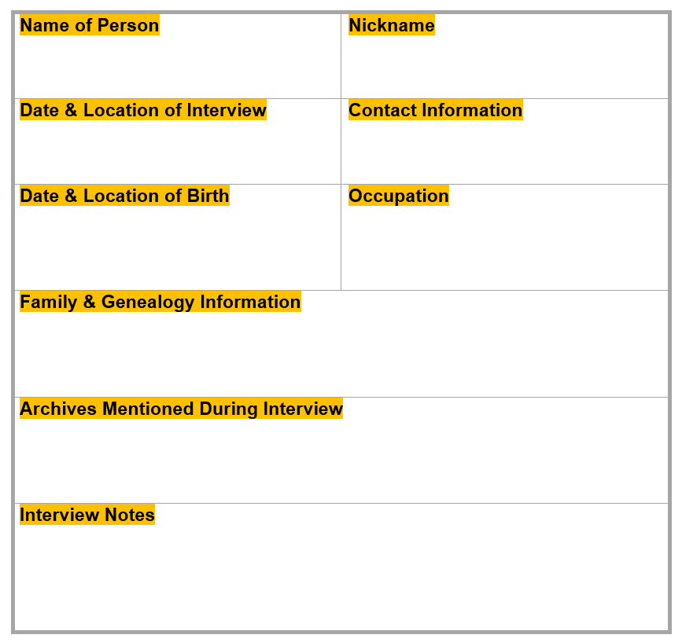
Interview Information Form Activity
Fill out the form and prepare for the
interview by conducting preliminary research on person.

Slide 12
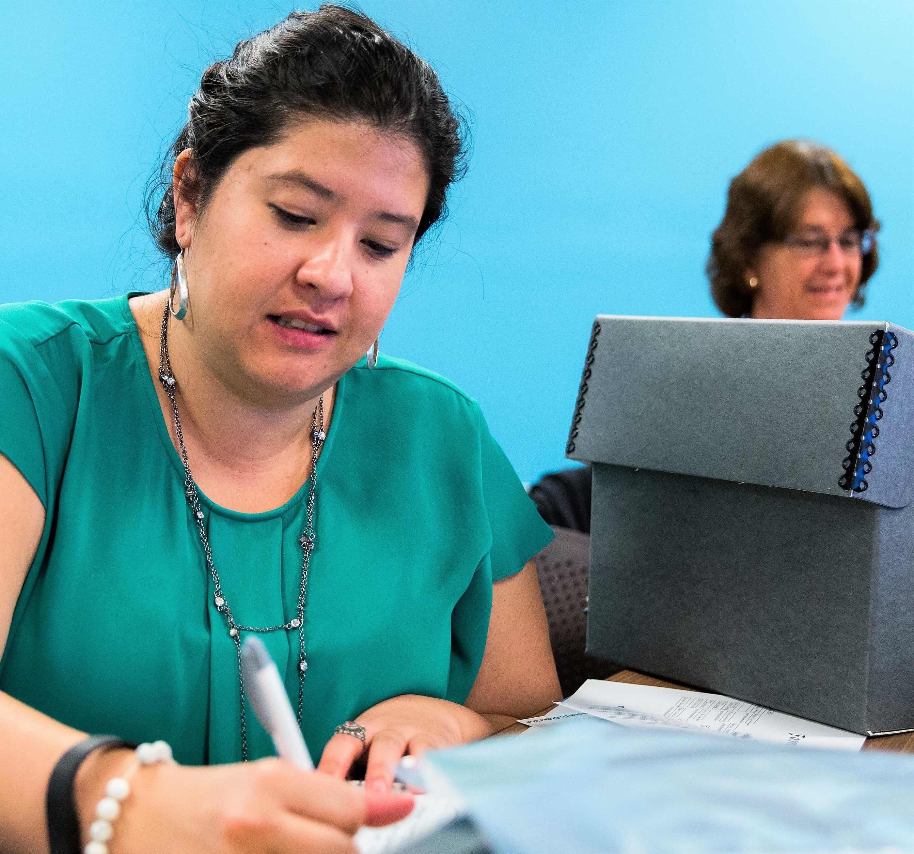
2. Create an outline for the interview.
Share outline with the person you’re going to interview so they feel prepared. Ask them if they have photos they want to share during the interview.
Make sure you practice asking questions before the interview so you are comfortable.

Slide 13
3. Record the conversation.
Use an iPad, phone, or camera to record the interview.
Before you record, make sure the equipment is working.
Begin the interview by asking the person their name, date and time, and interview location.

Slide 14
Interview Practice Activity
Outline will provide structure during the interview
but encourage storytelling.

Slide 15
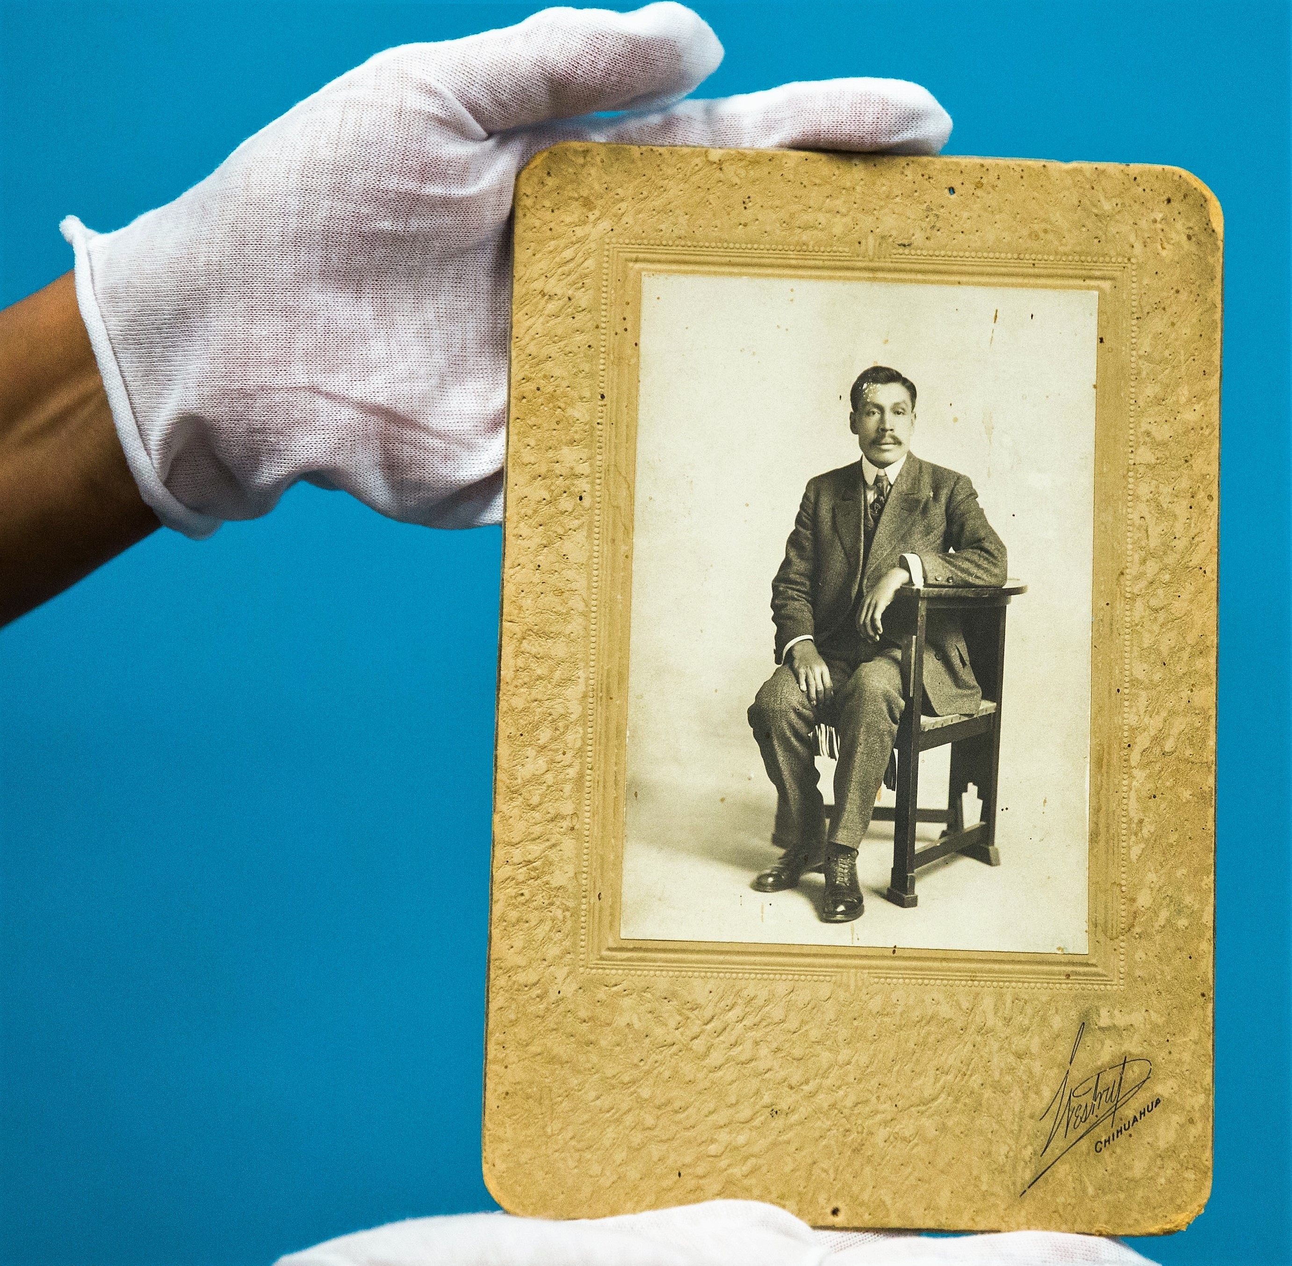
4. Edit and preserve the recording.
Create a transcript of recording. You can do this by hand or use special software.
If archival material like photos is mentioned during the interview, make sure you scan photos. You can use these images if you edit the video.

Slide 16
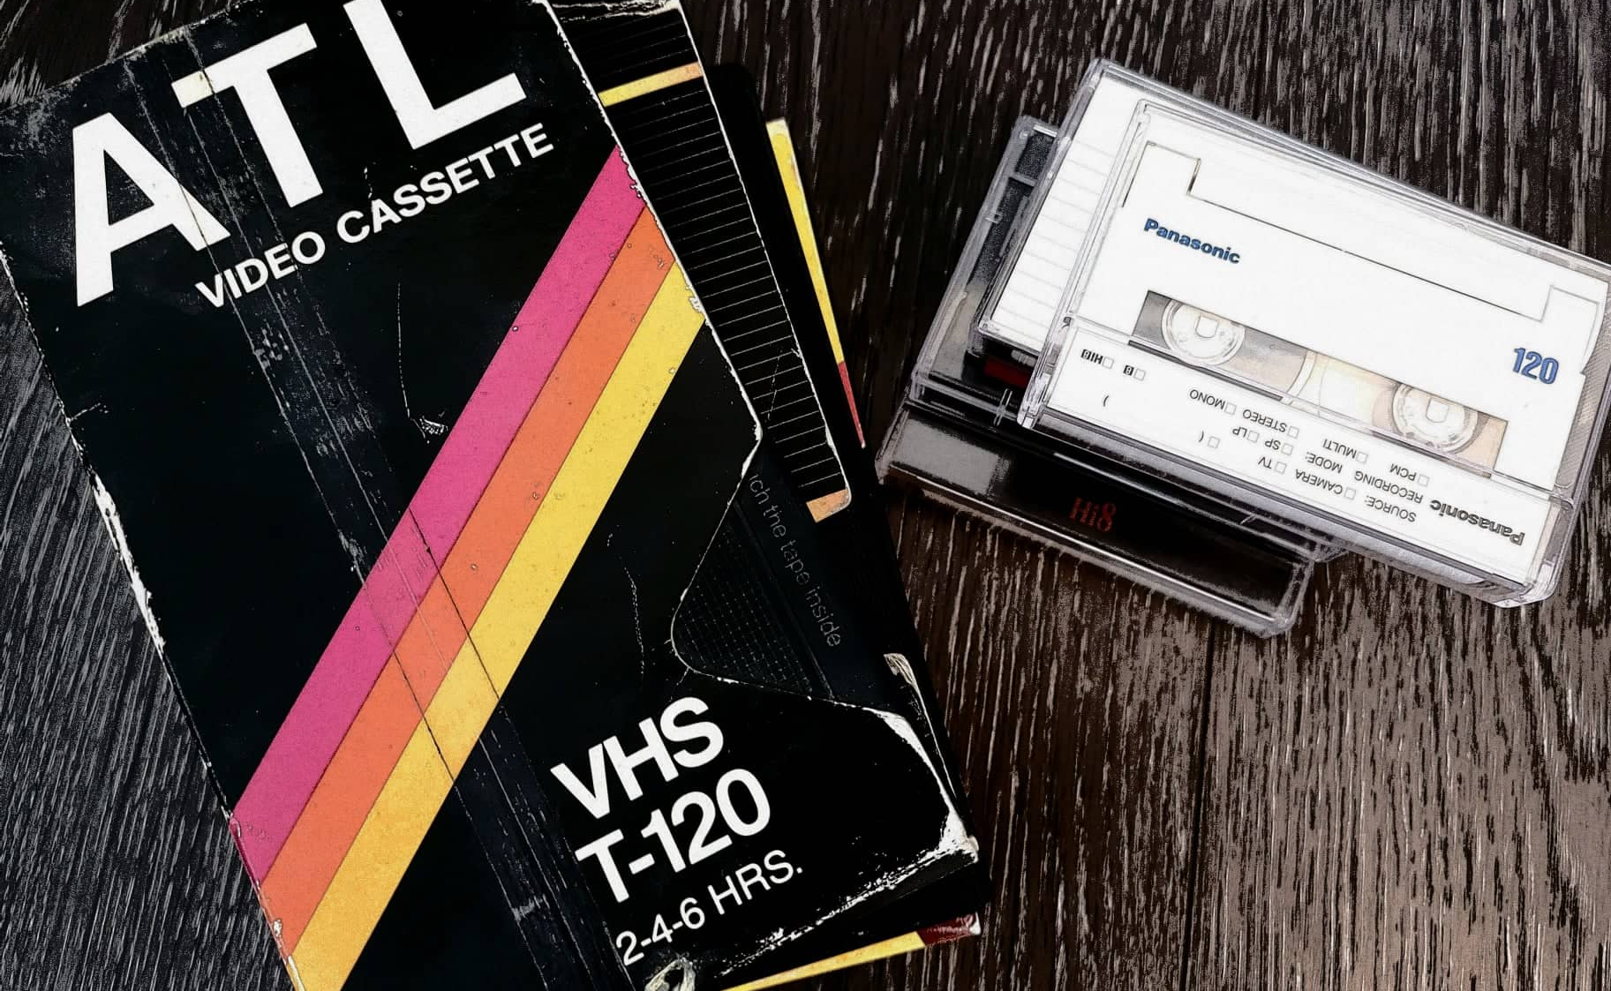
If you have a physical cassette or VHS, store the recording with your archival material in a safe temperature-controlled space. Example: Convert VHS to a digital file that can be stored on an external hard drive.

Slide 17
Access and Digital Preservation
Have the person sign a release form and donate to an archive. You can contact ASU Library to see an example of a form.
Make sure to organize your digital files by people and dates. Create unique titles for each file and folder.

Slide 18
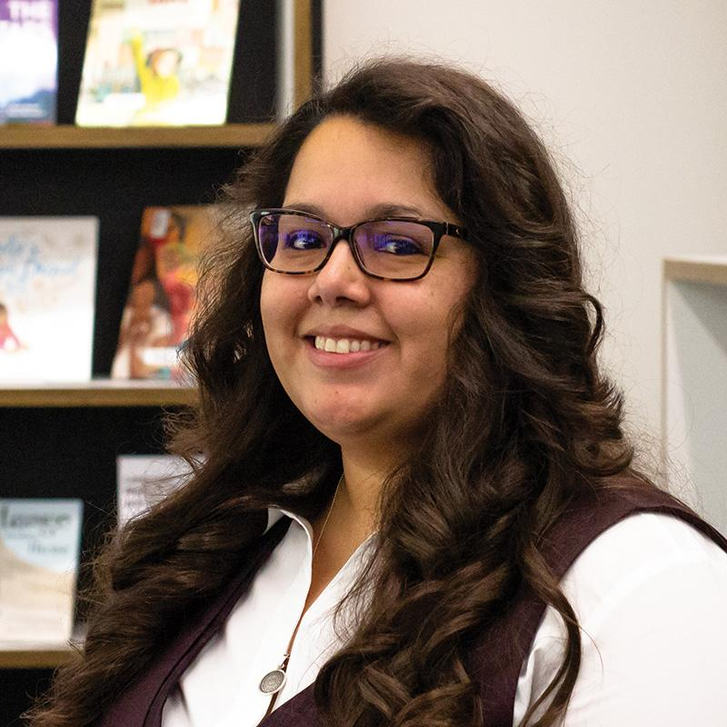
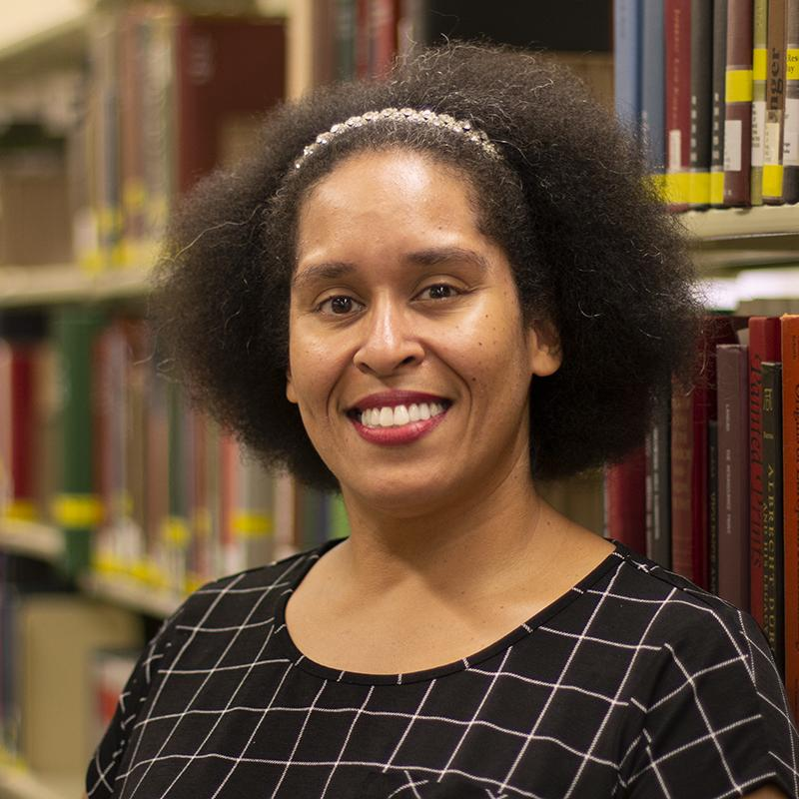
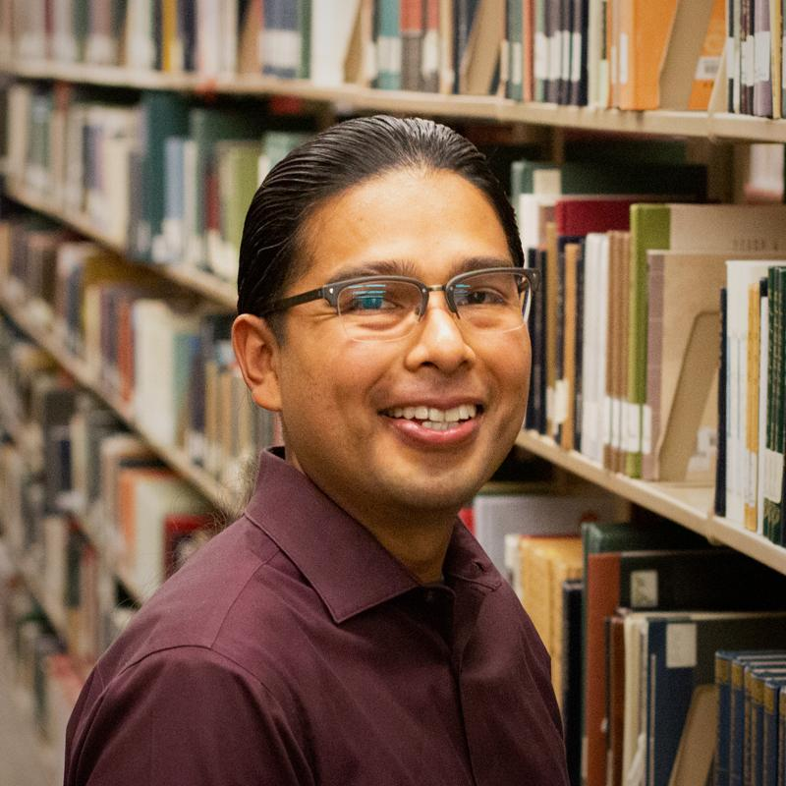
Community-Driven Archives (CDA) Initiative
Contact us!
Nancy Godoy Archivist, Chicano/a Research Collection
Head, Community-Driven Archives Initiative
Jessica Salow Archivist, Black Collections
Alex Soto
Director, Labriola National American Indian Data Center

Slide 19
Visit our website!
lib.asu.edu/communityarchives

