Slide 1
CDA Escuelita for
Young Archivists
Presentation #1

Slide 2
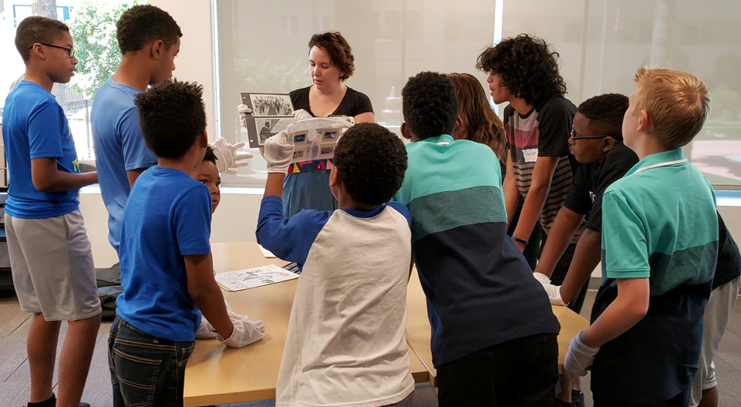
CDA Escuelita
Students as Community Archivists
The CDA Escuelita, or “Little School” is a program created by the Community-Driven Archives (CDA) Initiative at the Arizona State University (ASU) Library, which teaches students about archives and so they know they are the future, and the future of archives as well!
Notes:
Any photo can replace this photo to support your presentation.

Slide 3
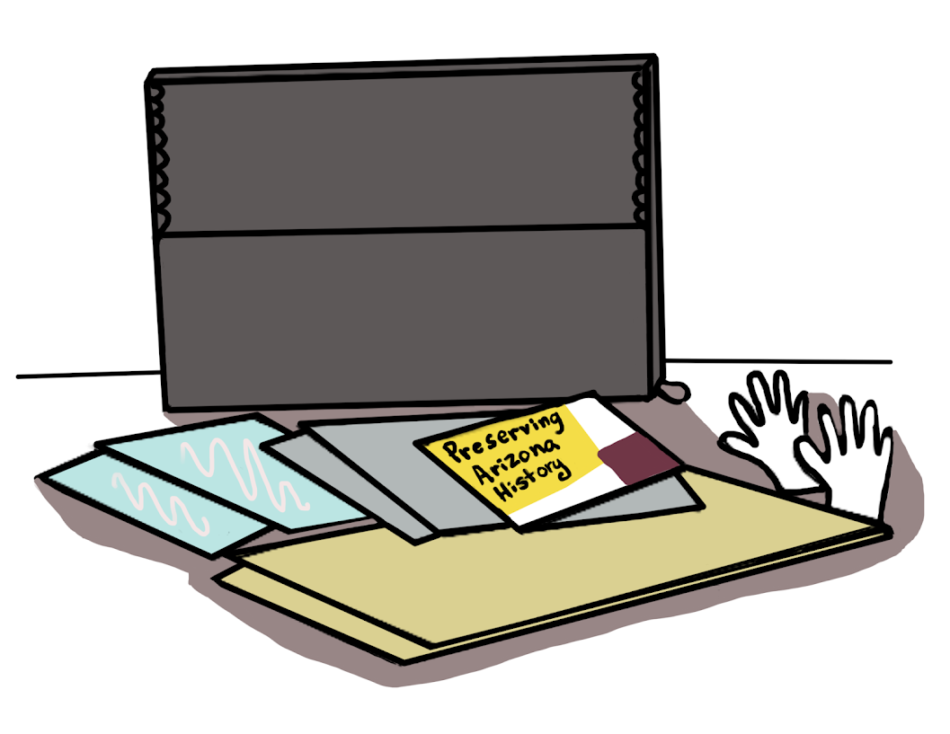
What are Archives?
An archive is a collection of special things that tell your story.
Some libraries, like ASU Library, take care of archives for future generations to learn about the past.
An archive is like a time capsule and where past and present come together, and preserves (keeps safe) the history of several generations.
Help keep your stories and history safe with your archive kits!

Slide 4
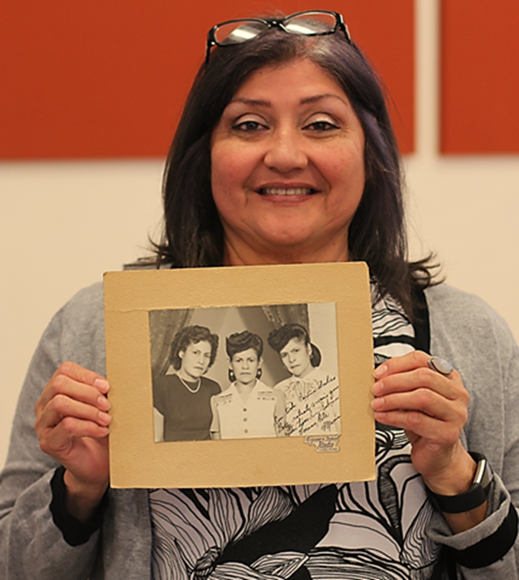
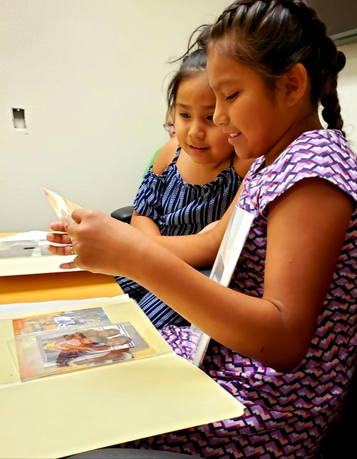
What is an Archivist?
An archivist is someone who protects archives and helps people learn about history.
You can be an archivist!
You can learn to be an archivist at any age.

Slide 5
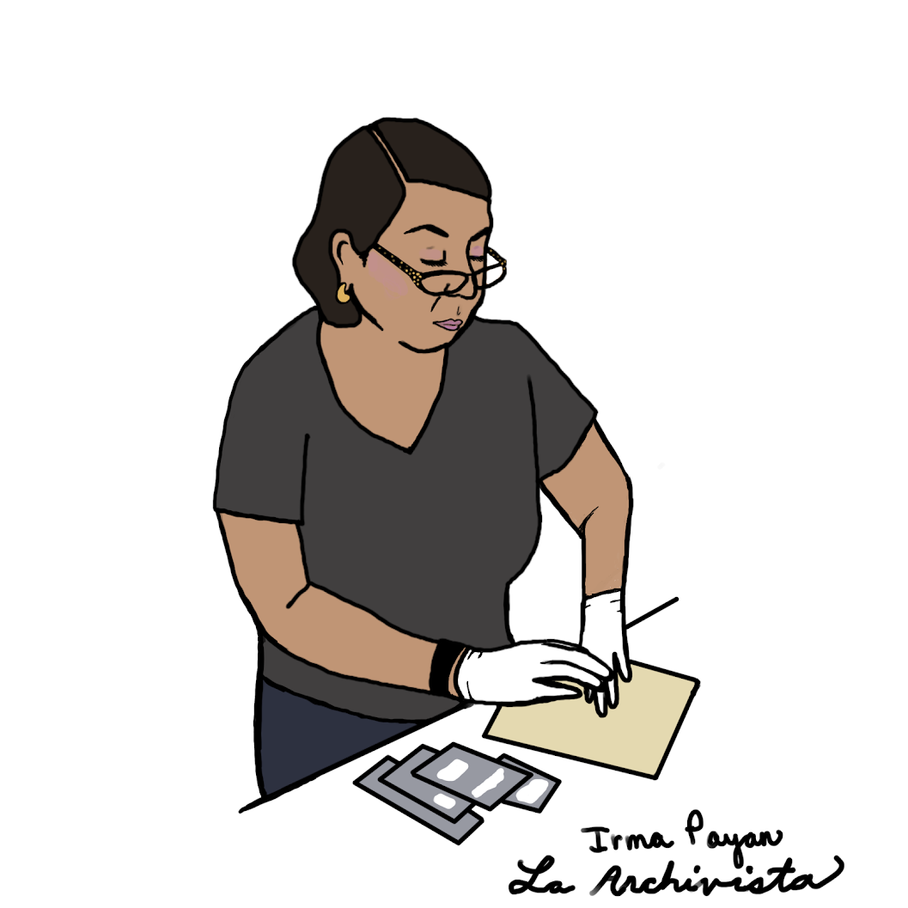
What is a Community Archivist?
A community archivist is someone from any community that also keeps their archives safe and helps people learn about history.
You can also be a community archivist!
Irma Payan is a community archivist. She now teaches others how to keep their archives safe and that their history is important.

Slide 6
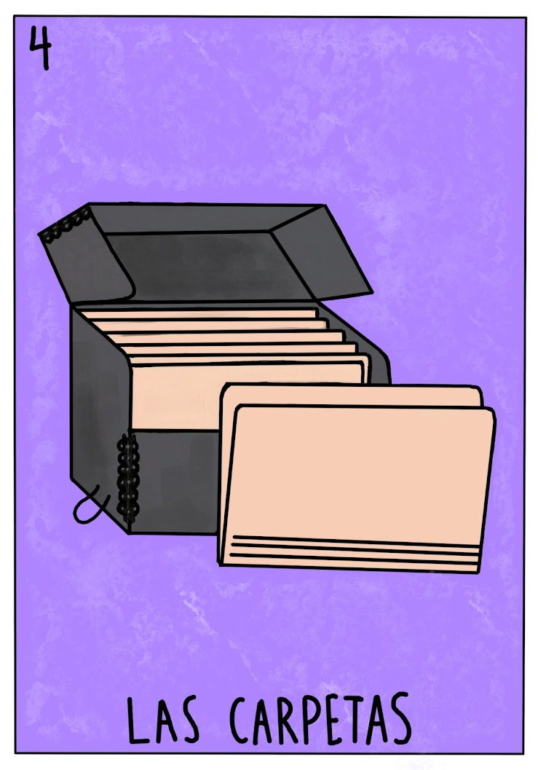
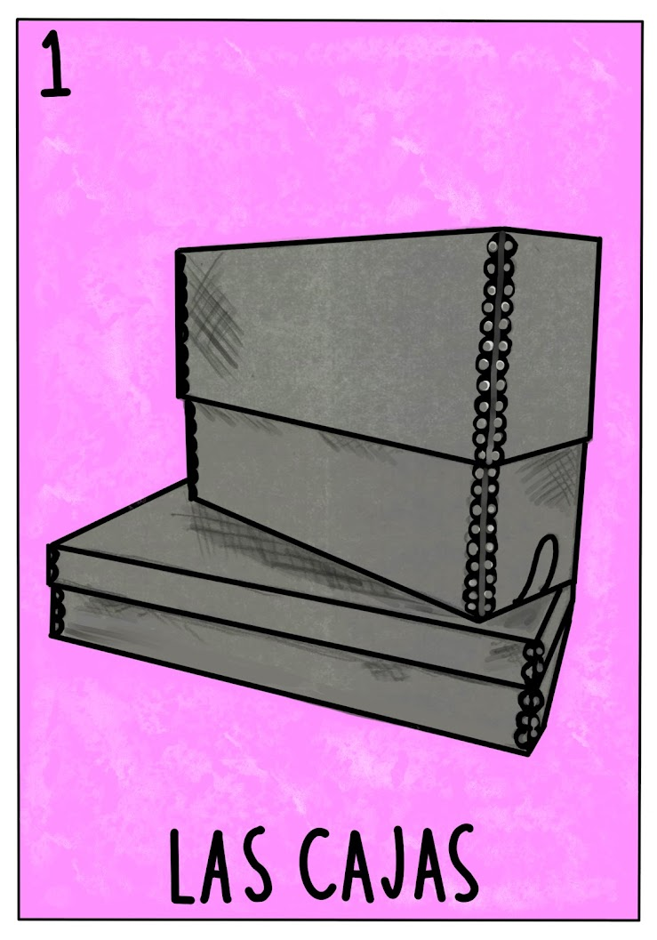
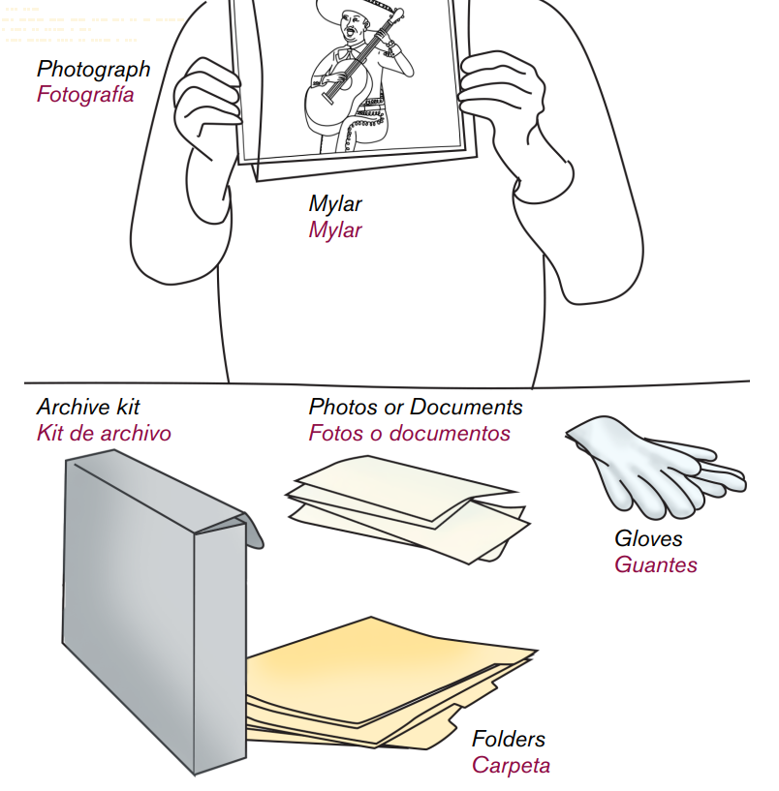
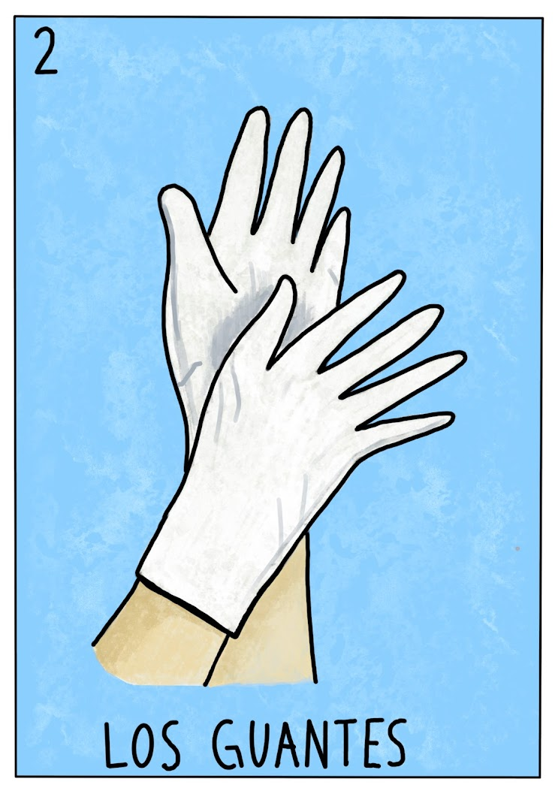
Archive Supplies
Our Loteria Cards have Archives supplies on them.

Slide 7
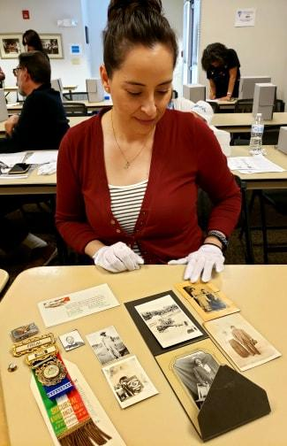
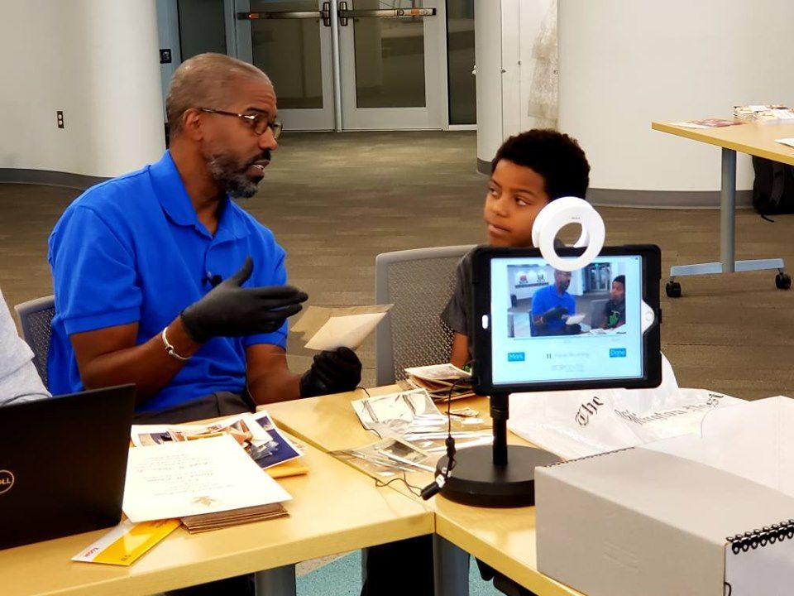
What can go in your archive?
Most archives have photos, documents, and objects.
Do you have photos, artwork, or a favorite toy?
You can put so many things in your archive!
Here, a community archivist sees that you can put a medal, a letter, and old family photos in an archive.

Slide 8
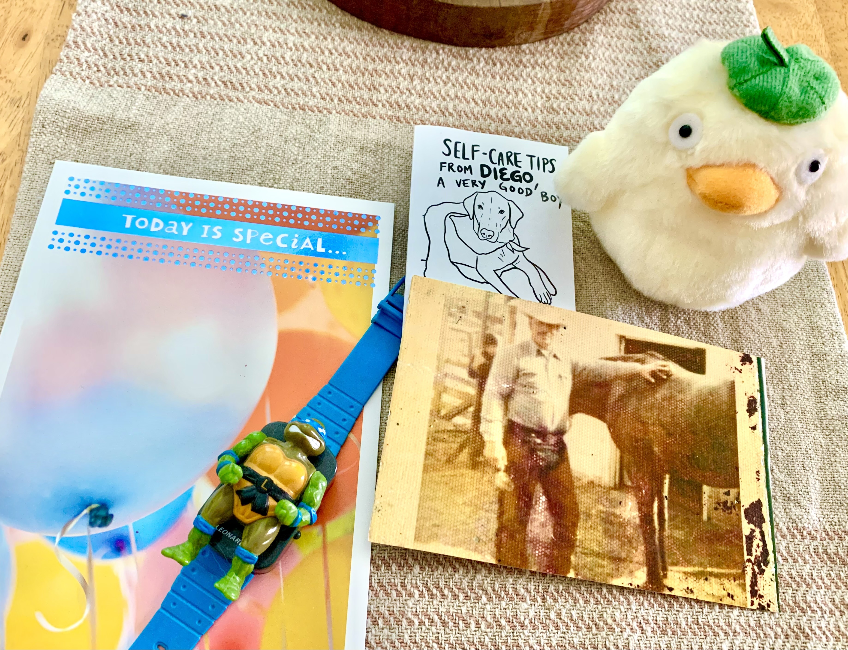
What is in YOUR archives?
You may have:
Photos, Collages
Drawings, Paintings
Letters, Postcards, Notes
Assignments, Class Projects
Diaries, Sketchbooks
Remember that your items are important! No matter how big or small they are!

Slide 9
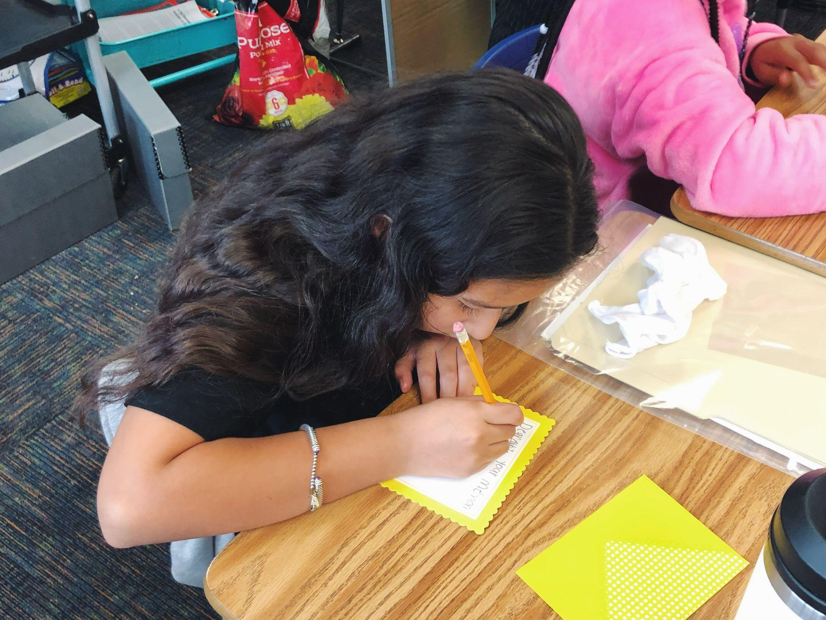
Activity 1: Write a Letter
Write a short letter to yourself:
(today's date)
Dear (your name),
Your memories are important. You are important.
*You may add more to this letter if you want!
*Put your letter in an envelope, do not seal it.
Add your letter to your archive and continue to make memories to add to your archive kit!

Slide 10
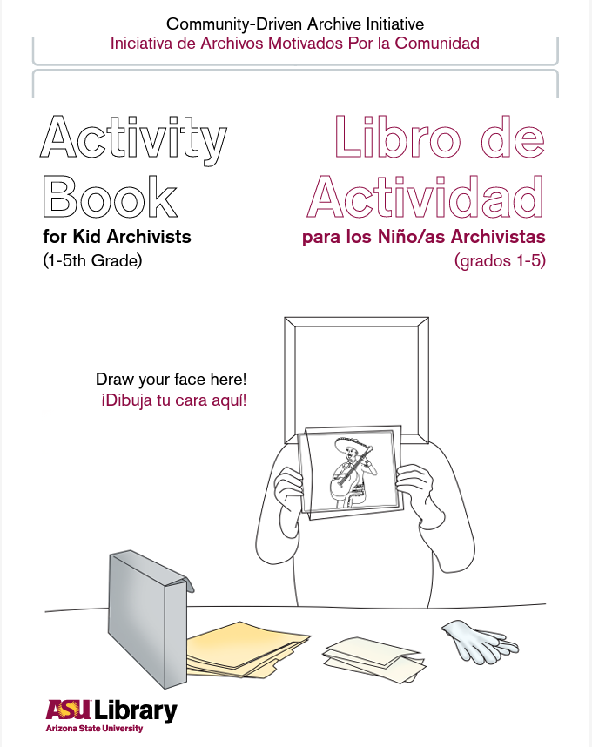
Activity 2: Kid Archivist Booklet
Put your name on the front of your booklet.
Work on the page of your kid archivist booklet which asks you to draw your family.
If there is time, you may work on the following pages.
This booklet can go in your archive!

